Slide 1
Architecture Proposal
Zhaolei

Slide 2
Assumptions
能源行业ERP SaaS
拿到融资
云创计划
速度
低运维能力，高开发能力
老板是传统行业的后起之秀
致力于Spring cloud微服务化
运行在自己的服务器上

Slide 3
Requirements & problems
Security
Security of data at rest and in transit
Self-healing infrastructure that recovers from failed service instances
Securing access to the environment as the delivery team expands
Disaster recovery
Cost
Cost efficiency
Archival strategy for inactive objects greater than 6 months
Performance
Ability to configure database and data access layer for high performance and throughput
Making the user experience in the browser very low latency even though a large portion of their user base will be from far away
Effective distribution of load
Ability to easily manage and replicate multiple environments based on their blueprint architecture

Slide 4
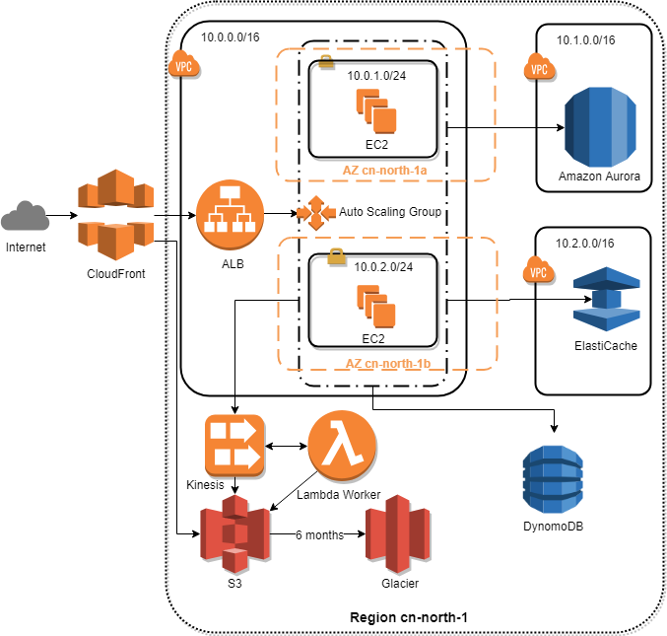
Architecture Proposal

Slide 5

Raise Goldfish, not sweat BMW
Notes:
Scaling to meet the demand, but with uncertainty around when and how much this demand will be they are very concerned about buying too much infrastructure too soon or not enough too late 性价比 性价比 Save money in the long run 价目对比 便宜 CIO选型 金鱼而不是汗血宝马

Slide 6
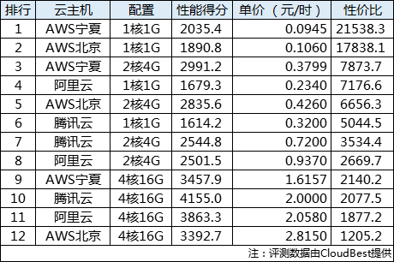
Reasonable price
http://cloud.idcquan.com/yjs/134551.shtml
Notes:
CIO价格选型的故事 横向扩展而不是向上扩展 一开始可以向上扩展，但是后来一定是横向扩展

Slide 7
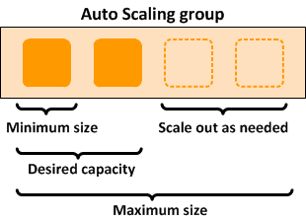
Save money in the long run by Auto Scaling
Notes:
Scaling to meet the demand, but with uncertainty around when and how much this demand will be they are very concerned about buying too much infrastructure too soon or not enough too late
Self-healing infrastructure that recovers from failed service instances
核心理念揽财
Save money
Easier for you to perform better
CloudWatch 命令行 CloudFormation
druid.io
甩手掌柜

Slide 8
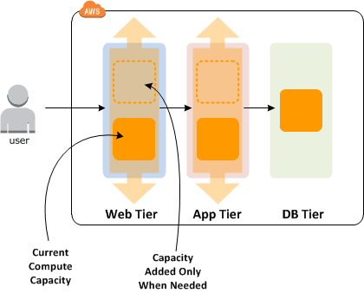
Save money in the long run by Auto Scaling
Notes:
Scaling to meet the demand, but with uncertainty around when and how much this demand will be they are very concerned about buying too much infrastructure too soon or not enough too late
Self-healing infrastructure that recovers from failed service instances
核心理念揽财
Save money
Easier for you to perform better
CloudWatch 命令行 CloudFormation
druid.io
甩手掌柜

Slide 9
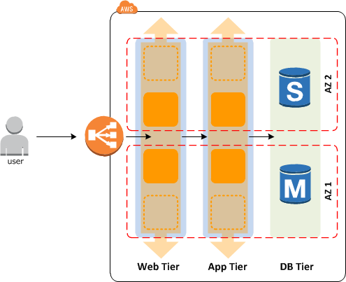
Effective distribution of load to Availability zones
Availability zones — Two are used. If one availability zone (AZ) suffers from an outage, we still have EC2 instances running in the other AZ.
Notes:
Scaling to meet the demand, but with uncertainty around when and how much this demand will be they are very concerned about buying too much infrastructure too soon or not enough too late
Self-healing infrastructure that recovers from failed service instances
核心理念揽财
Save money
Easier for you to perform better
CloudWatch 命令行 CloudFormation
druid.io
甩手掌柜

Slide 10













轻松管理
高度可扩展
可用且持久
快速
安全
便宜
Notes:
Ability to configure database and data access layer for high performance and throughput Security of data at rest
备份 计费和使用简单
Save money Easier for you to perform better
安基ERP项目，不再焦虑不懂数据库运营，依赖外部谈判，轻松备份。
不需要DBA

Slide 11
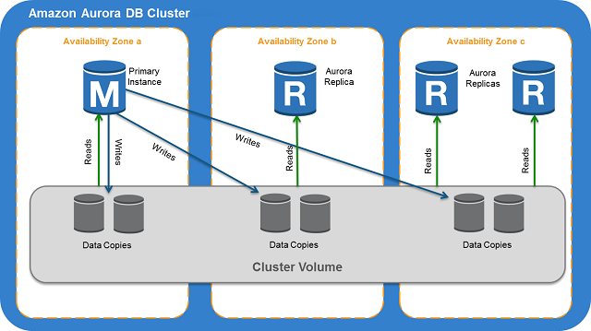
Notes:
Ability to configure database and data access layer for high performance and throughput Security of data at rest
备份 计费和使用简单
Save money
Easier for you to perform better
安基ERP项目，不再焦虑不懂数据库运营，依赖外部谈判，轻松备份。
不需要DBA

Slide 12
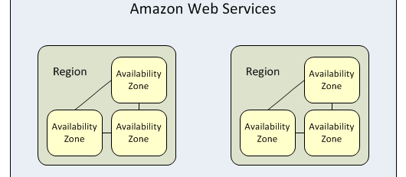
Don't put eggs in one basket
Notes:
Region & Availability zones
Disaster recovery
正直。。Your strong support
北京，宁夏
鸡蛋不要放在一个篮子里

Slide 13
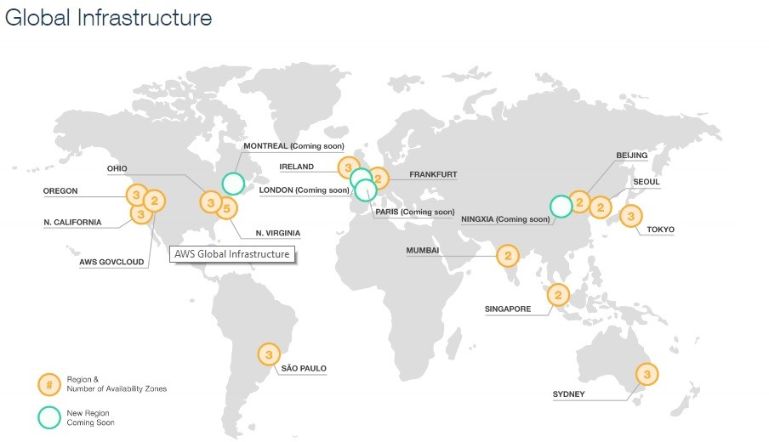
Notes:
Region & Availability zones
Disaster recovery
正直。。Your strong support
北京，宁夏
鸡蛋不要放在一个篮子里

Slide 14
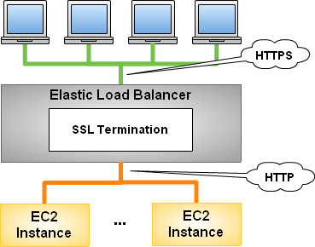
Security of data in transit using HTTPS
Notes:
ALB Security of data in transit
没有单台机的带宽限制
Easier for you to perform better
CIO故事：让AWS来操心HTTPS配置的问题，而不是找网管或者自己配置各种服务器

Slide 15
Easier for you to perform better
Notes:
不要让用户怀疑你的技术能力.创业故事, OSS + EC2 + dynamoDB

Slide 16
Just remember 3 point
Save money in the long run
Easier for you to perform better
Your strong support

